Slide 1
A Hybrid brain computer interface based on SSVEP/MI for controlling an exoskeleton wrist with 1 DOF
Yifang (Gloria) HOU, rongze (rebecca) ma
Mechatronics Engineering, Supervised by Professor xie

Slide 2


WHAT IS BCI?
Brain Computer Interface: a system which allows the user to communicate with machines using brain waves without physical movement
Electrode
Electrode along scalp [1]
[1] Wolpaw, J. R., and Wolpaw, E. W. (2012). Brain-Computer Interfaces Principles and Practice. Oxford University Press.

Slide 3
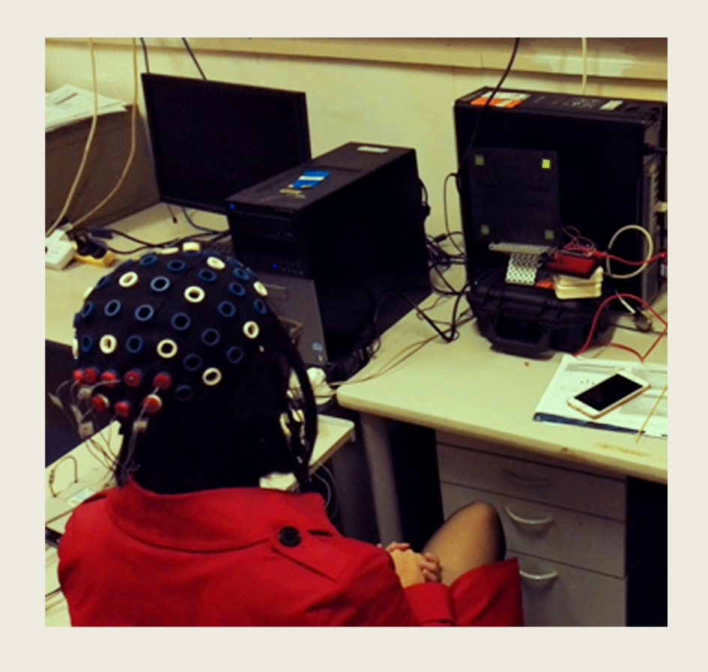
Ssvep based bci system
SSVEP responses are triggered by visual stimuli
e.g. Flickering LED lights
Test subject gazing at the flickering light

Slide 4

MI based bci system
MI responses triggered by imagination of body movements
Control external devices without any physical interactions
TELEKINESIS!

Slide 5

significance
Clinical studies proved that MI-based BCI systems are more efficient than the traditional passive rehabilitation process [2]
MI based BCI systems are found to be slow with relatively low accuracy rate
Hybrid system can take advantages of each individual BCI system
Traditional passive rehabilitation process
[2] Ang.K, Chua,K, Ang.B, Kuah.C, Wang.C, Phua.K, Chin.Z, Zhang.H (2009). A clinical study of motor imagery-based brain-computer interface for upper limb robotic rehabilitation, in Proceeding of 2009 Annual International Conference of the IEEE Engineering in Medicine and Biology Society, pp.5981-5984.

Slide 6
OBJECTIVE
Develop a sequential SSVEP-MI based Hybrid BCI system to control a 1 DOF artificial arm
SSVEP: controls downward movement
MI: controls upward movement
Simultaneous
Sequential
Two hybrid BCI types

Slide 7
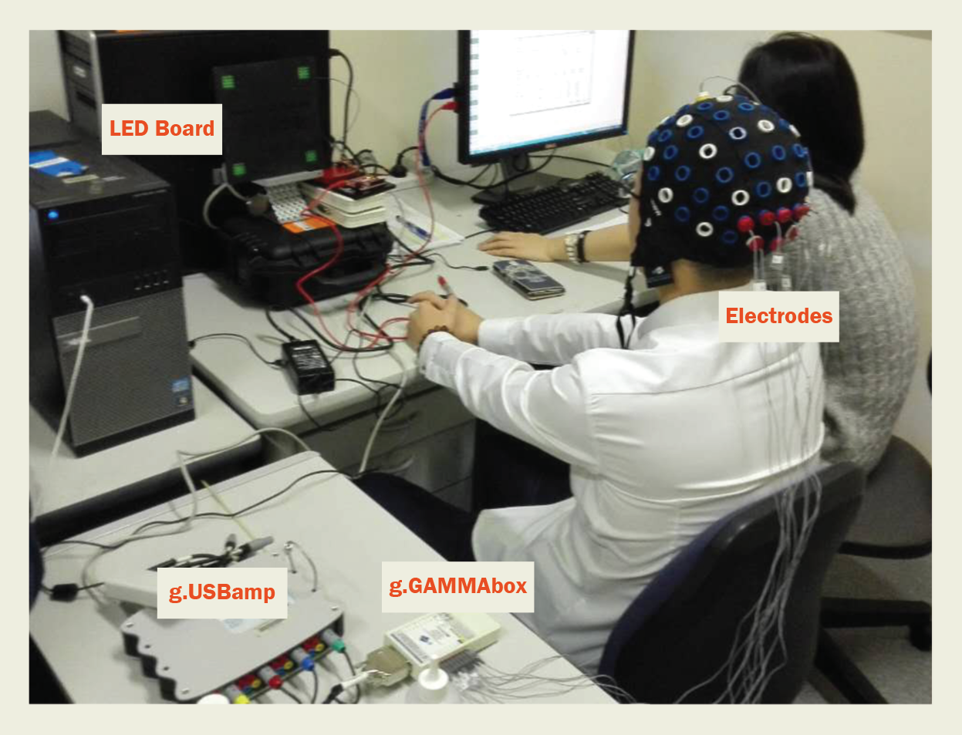
hardware
Front
mi
SSVEP
Back
Equipment setup
International 10–20 system

Slide 8
artificial arm
1 DOF artificial arm

Slide 9

Offline experiments
To determine important parameters that will be needed in the final online hybrid system
SSVEP: 18 test subjects were recruited
MI: 8 test subjects were recruited
A total of 4 findings

Slide 10
Ssvep: RESULTS #1
Four frequencies, 10, 11, 12 and 13Hz were tested
11/18 test subjects had the highest SSVEP response at 10Hz ± 0.05
Visual fatigue has a large effect on the performance
Sample result using 10Hz stimulus frequency

Slide 11
Ssvep: RESULTS #2
Accessed the effect of covering the dominant eye on SSVEP response
92% of the results showed a decrease in amplitude and SNR with varying degrees
Position of the stimuli is important at obtaining satisfactory responses

Slide 12
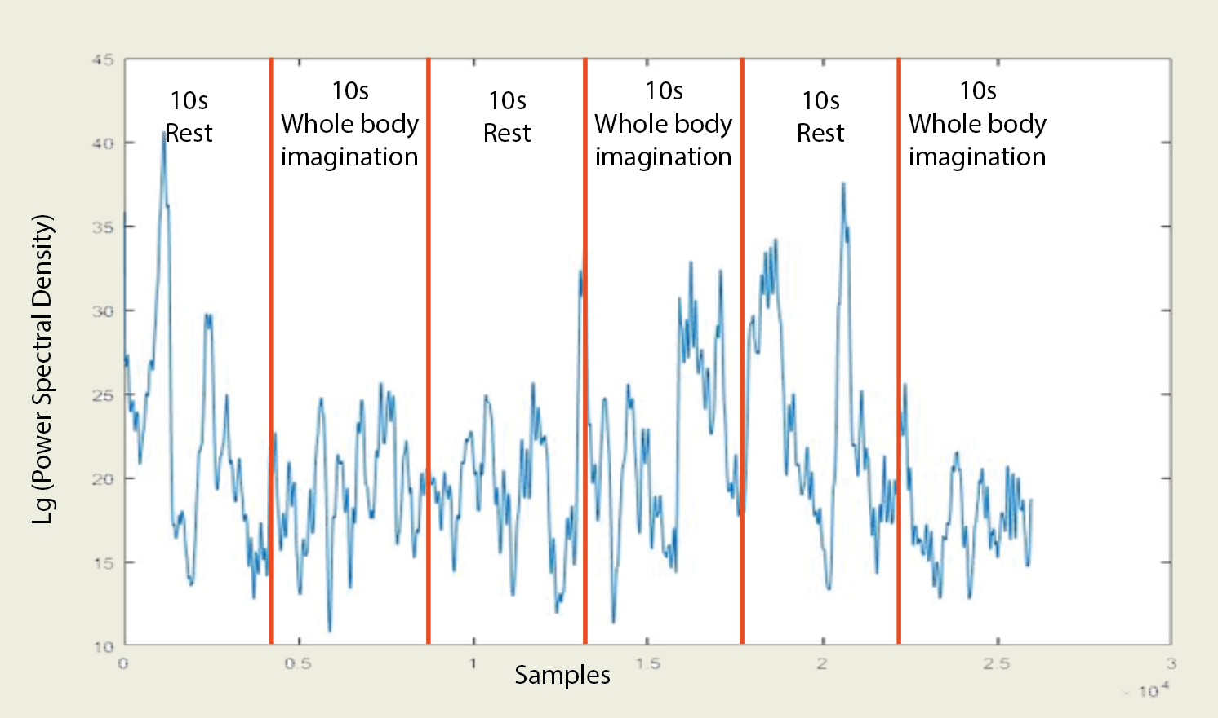
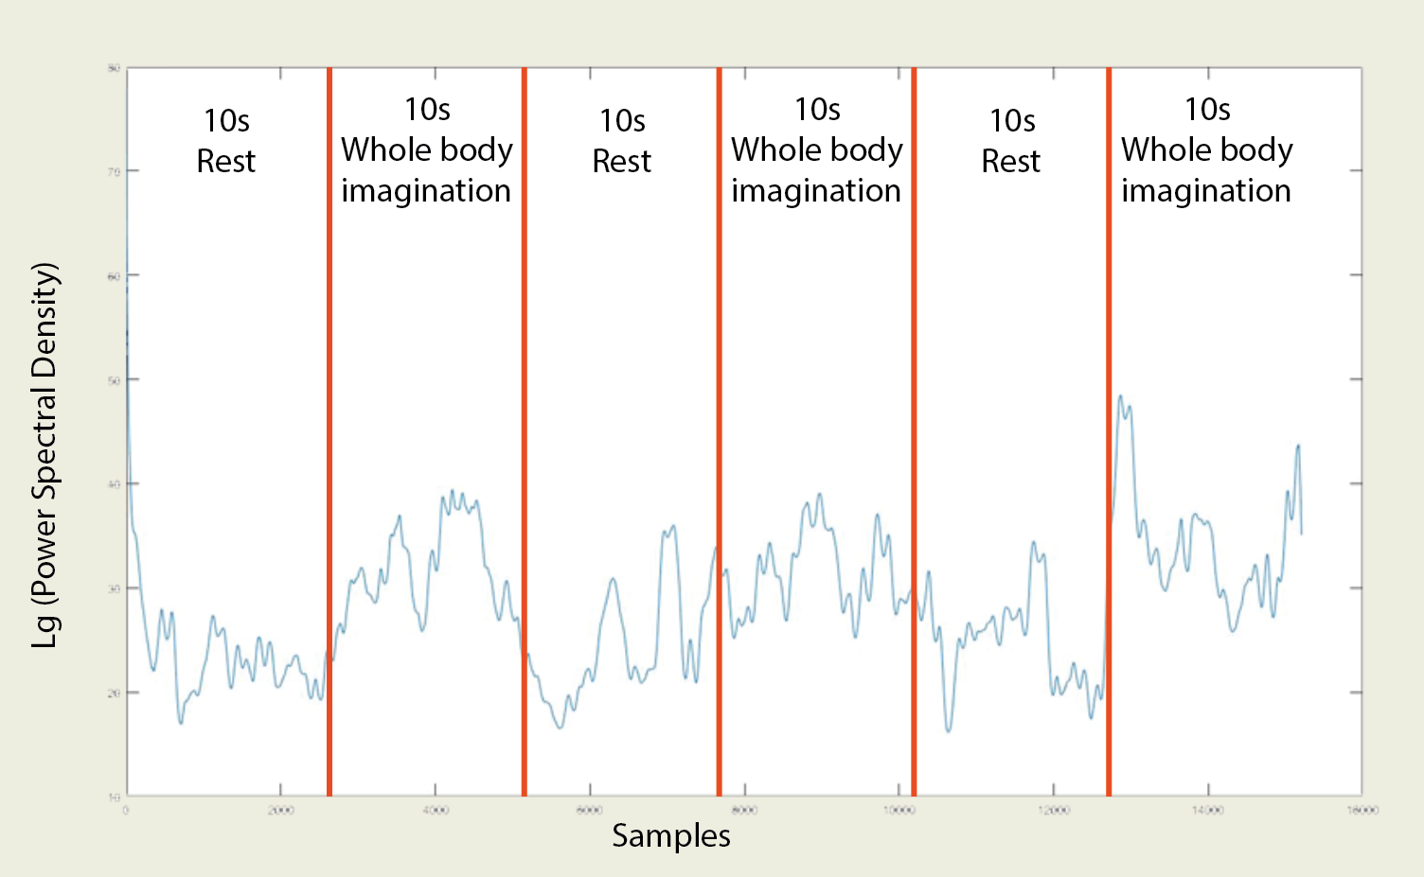
MI: RESULTS #1
Training is important for obtaining satisfactory MI responses
The more vivid the user can imagine, the best the MI response
Training is a fantastic process at helping the user to improve the way they imagine
Sample result obtained from test subject with no previous training
Sample result obtained from another test subject with no previous training
Sample result obtained from test subject with previous training

Slide 13
MI: RESULTS #2
15s
15s
15s
15s
Signal analysing method is one of the key aspect in BCI system design
The more active the brain is, the better the MI response
Sample result showing the difference between single hand movement imagination and whole body movement imagination

Slide 14
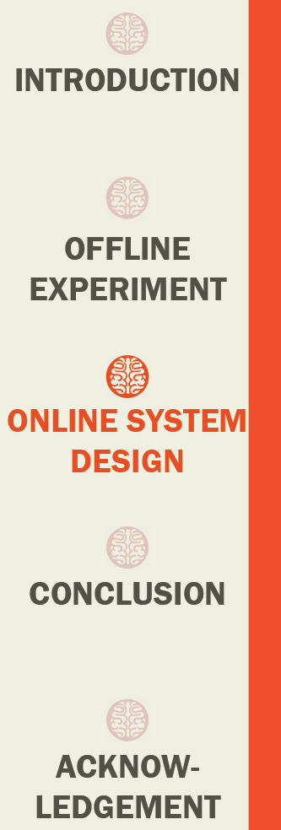
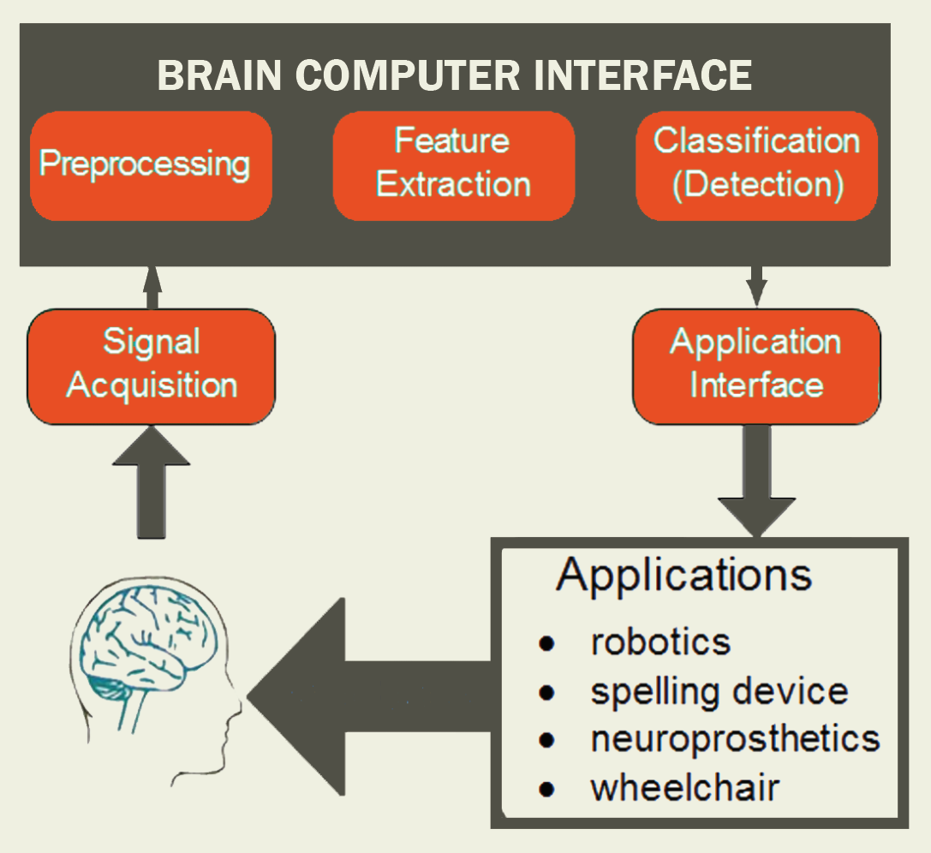
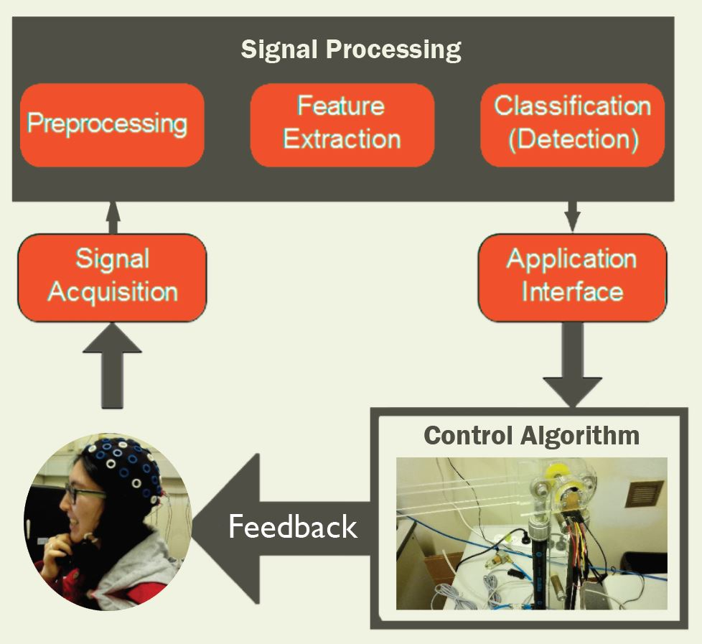
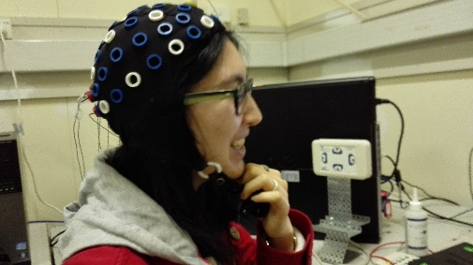
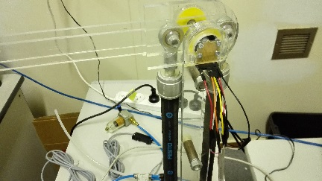
Online system structure
Closed-loop system:
Signal Generation
Signal Acquisition
Signal Processing
Application Interface
Control Algorithm
Feedback
Feedback online BCI system

Slide 15
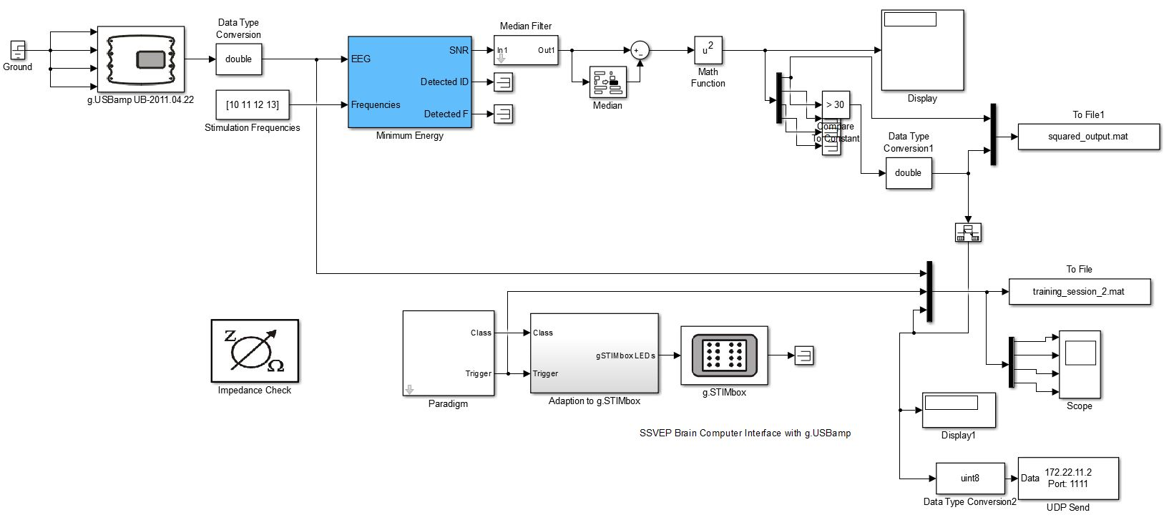
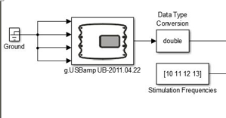
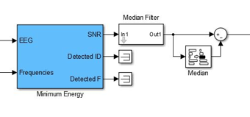
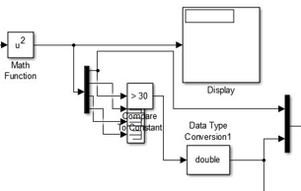
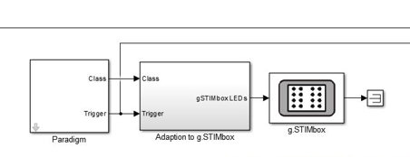
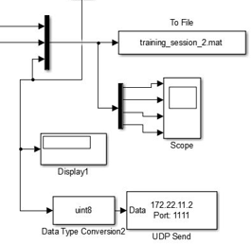
SINGULAR SSVEP BASED BCI
Signal Acquisition (DAQ)
Signal Processing
Application Interface
Signal Generation (stimuli: flickering LEDs)
SSVEP based BCI model in Simulink

Slide 16
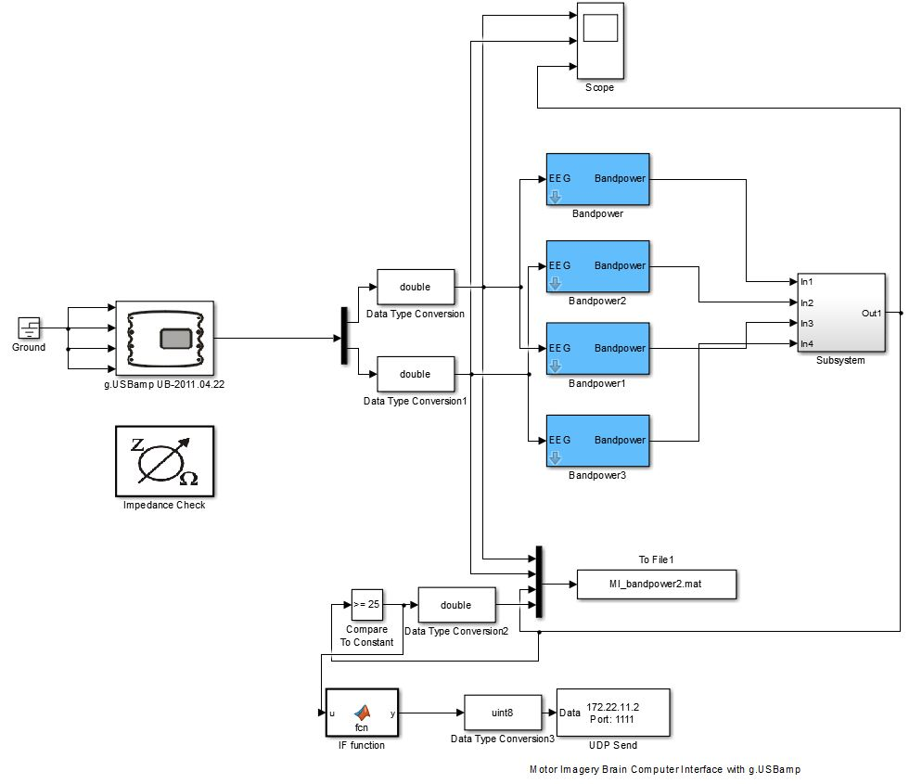
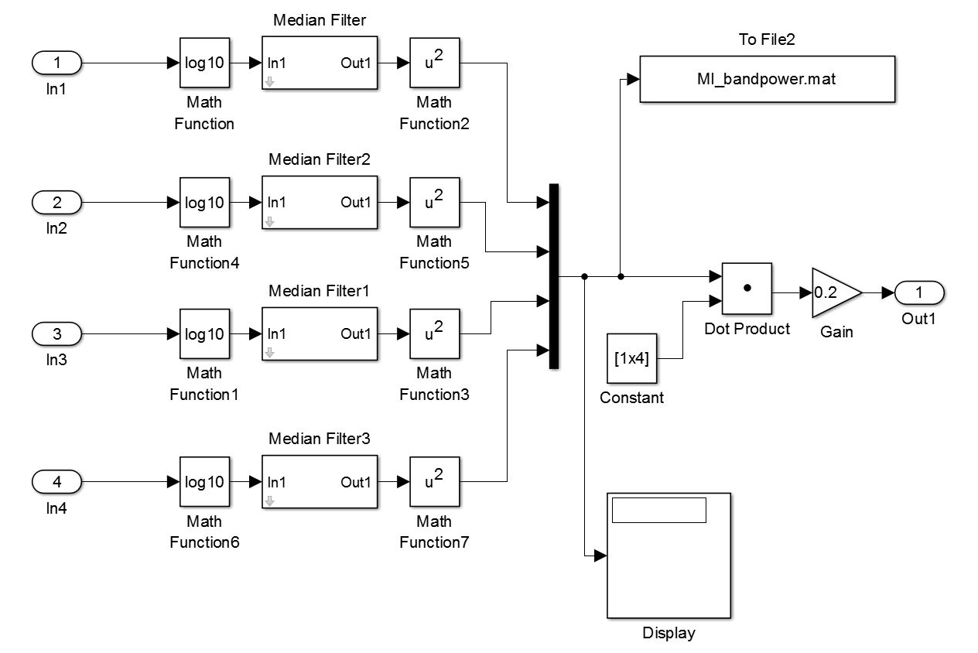
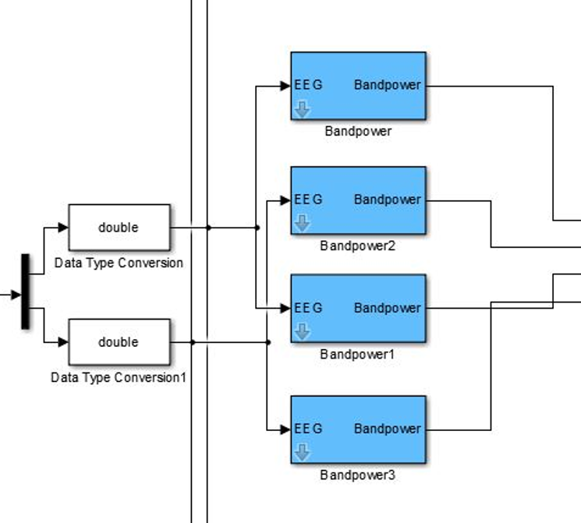
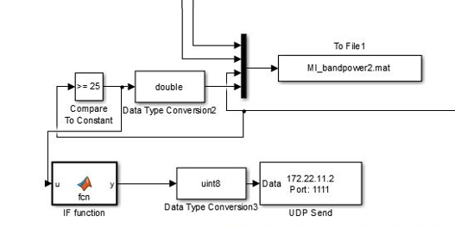
SINGULAR MI BASED BCI
Alpha band
Beta band
Signal Processing
Signal Generation (self-paced
control) & DAQ
Application Interface
MI based BCI model in Simulink

Slide 17
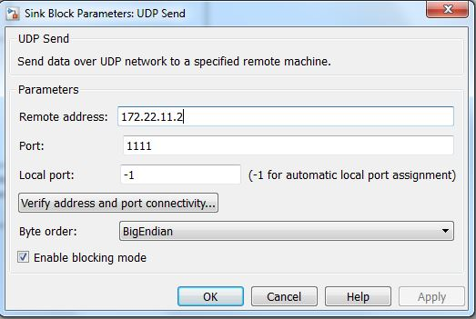
Udp server/client
Communicator between Simulink and Labview

Slide 18
Hybrid system
Develop a sequential SSVEP-MI based Hybrid BCI system to control a 1 DOF artificial arm
Selector classifies the current states: Relax (0), Gaze(1) or Imagine (2)
Digitized EEG signals from DAQ
Hybrid BCI logic diagram

Slide 19
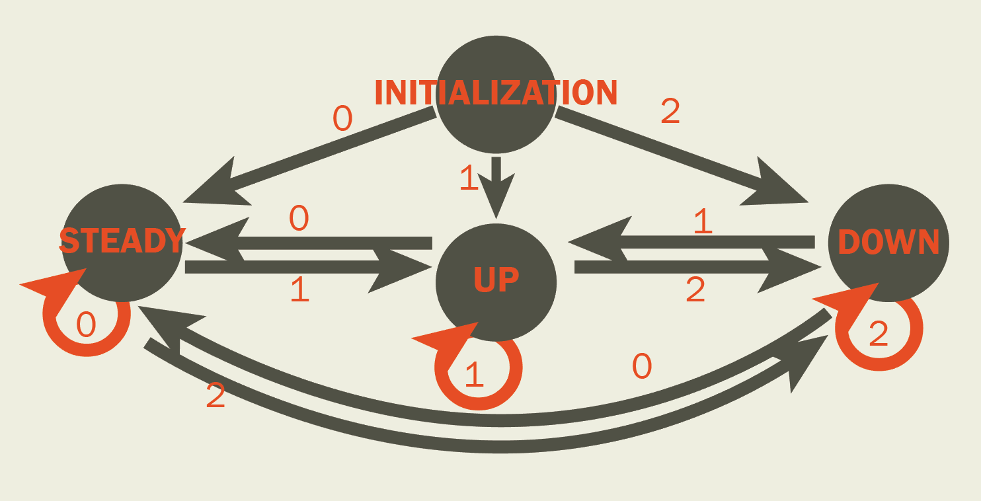
MOVEMENT CONTROL
Actuator in Labview defines the direction and angle of movements
State 0: angle stays the same. The artificial arm is neither moving upwards nor downwards.
State 1: decreases the current angle by 0.2º - moving downwards.
State 2: increases the current angle by 0.2º - moving upwards.
Movement range: ±30º
Movement control algorithms in Labview
Finite State Machine of Algorithms

Slide 20
RESULTS #1
Performance of online SSVEP model:
Threshold: 400
Accuracy: 98.17%
Operating delay: 2.5 sec.
Energy of signals changes over time
EEG magnitude
Time (sec)

Slide 21
RESULTS #2
Performance of online MI model:
Threshold: 60
Accuracy: 99.04%
Operating delay: 3.5 sec.
Power Spectral Density of MI changes over time
EEG magnitude
Time (sec)

Slide 22

RESULTS #3
Information Transfer Rate (ITR):
ITR =${(\frac{60}{T})×\{log}_{2}\left(N\right)+P×\log_{2}\left(P\right)+(1−P)×\log_{2}[\frac{1−P}{N−1}]$}
SSVEP: 24 bit/min
MI: 17.14 bit/min
Hybrid: 15 bit/min
Accuracy: 83.26%
Operating delay: 3-4sec.

Slide 23

conclusion
Both offline systems and their experiments are effective and accurate.
Enough number of test subjects but need to include more types of people.
A SSVEP-MI based hybrid online Simulink model developed successfully controls the movement of the 1 DOF artificial wrist.

Slide 24
Future work
Multi-channel control for rehabilitation devices with more than 1 DOF
Other analysis methods to improve online model performance
Other combination of BCI systems

Slide 25
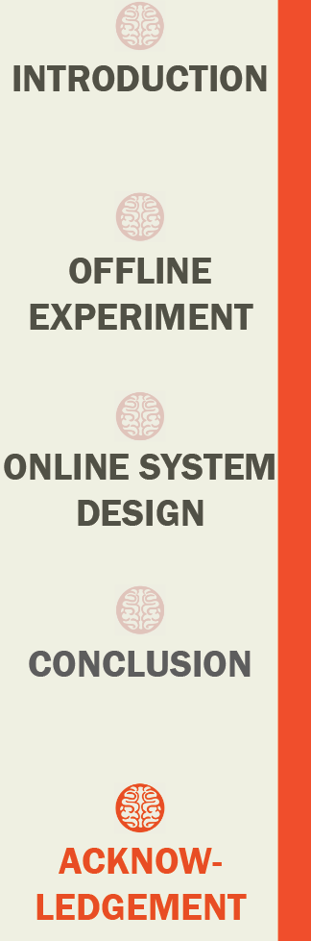
Acknowledgement
Professor Shane Xie for giving us this opportunity and guide us throughout the year
PhD students Mr Kiran Atal, Mr Wei Meng, Mr Yongje Kwon, Mr Yifeng (Evan) Chen for giving us their professional help whenever we encountered technical problems
All the technicians for helping us with the equipment supports
All our friends for willing to be our test subjects

Slide 26
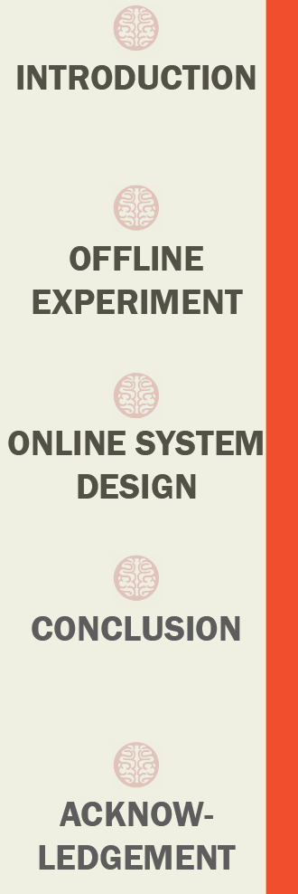


Thank you!

Slide 27


Q & A

